Slide 1
神经网络的凝聚现象
许志钦
2023年11月10日

Slide 2
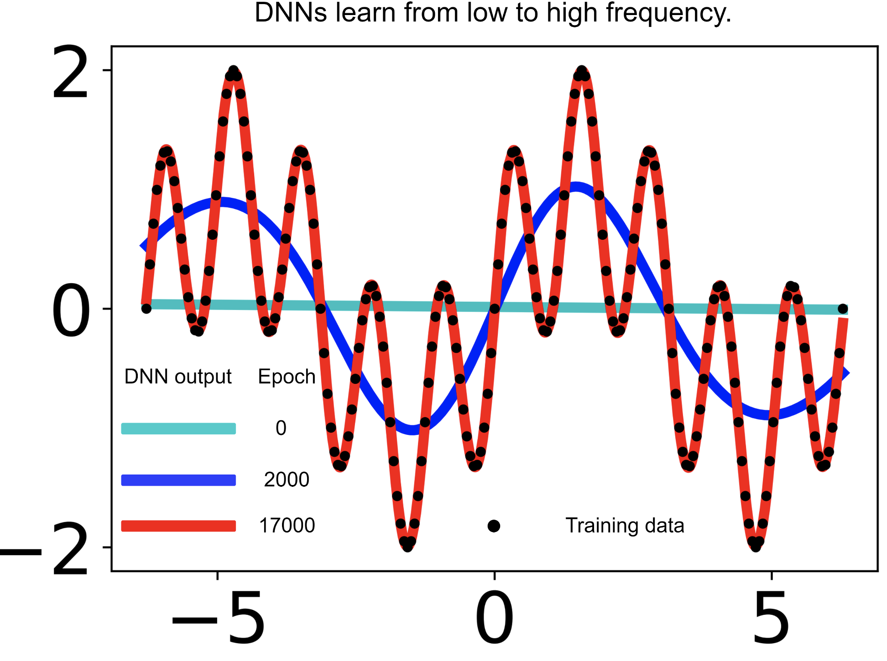
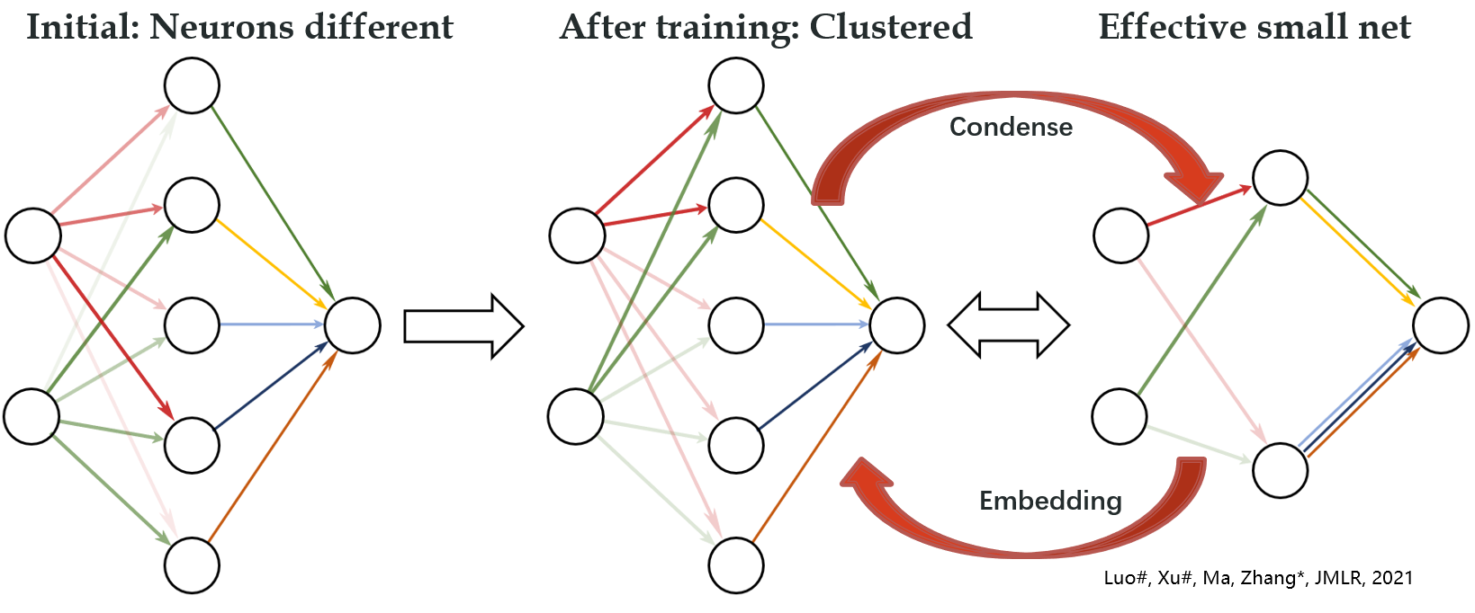
Simple bias in practice
Frequency Principle （频率原则）
Condensation
（参数凝聚）
Low-frequency bias
Few effective neurons

Slide 3
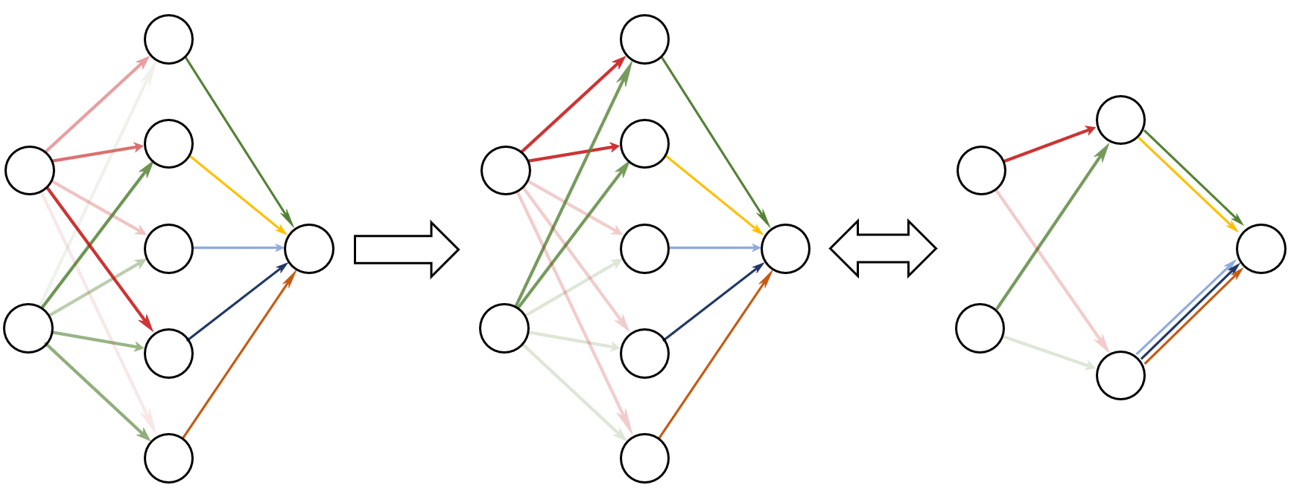
Condensation
Initial: Neurons different
After training: Clustered
Effective small net
Condense
Embedding
Luo#, Xu#, Ma, Zhang*, JMLR, 2021

Slide 4
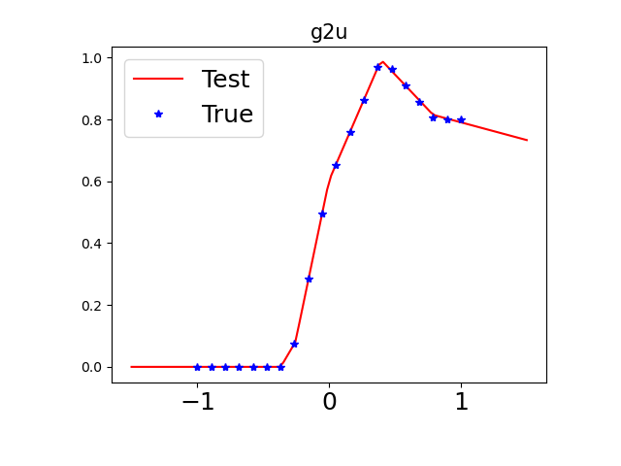
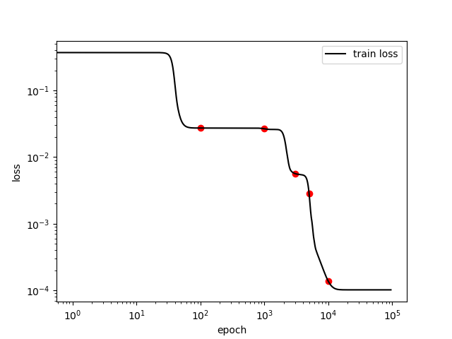
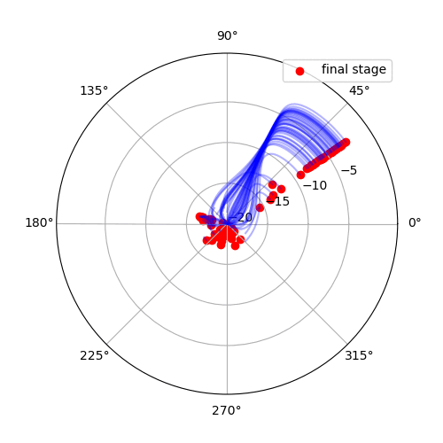
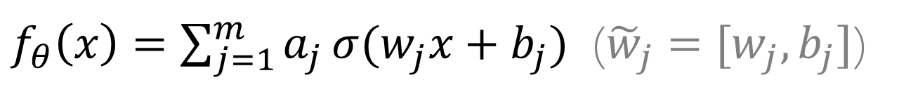
1d example
$f_{θ}\left(x\right)=\sum_{j=1}^{m}{a_{j}σ{(w_{j}x+b_{j})}}$ (${\tilde{w}}_{j}=[w_{j},b_{j}]$)

Slide 5
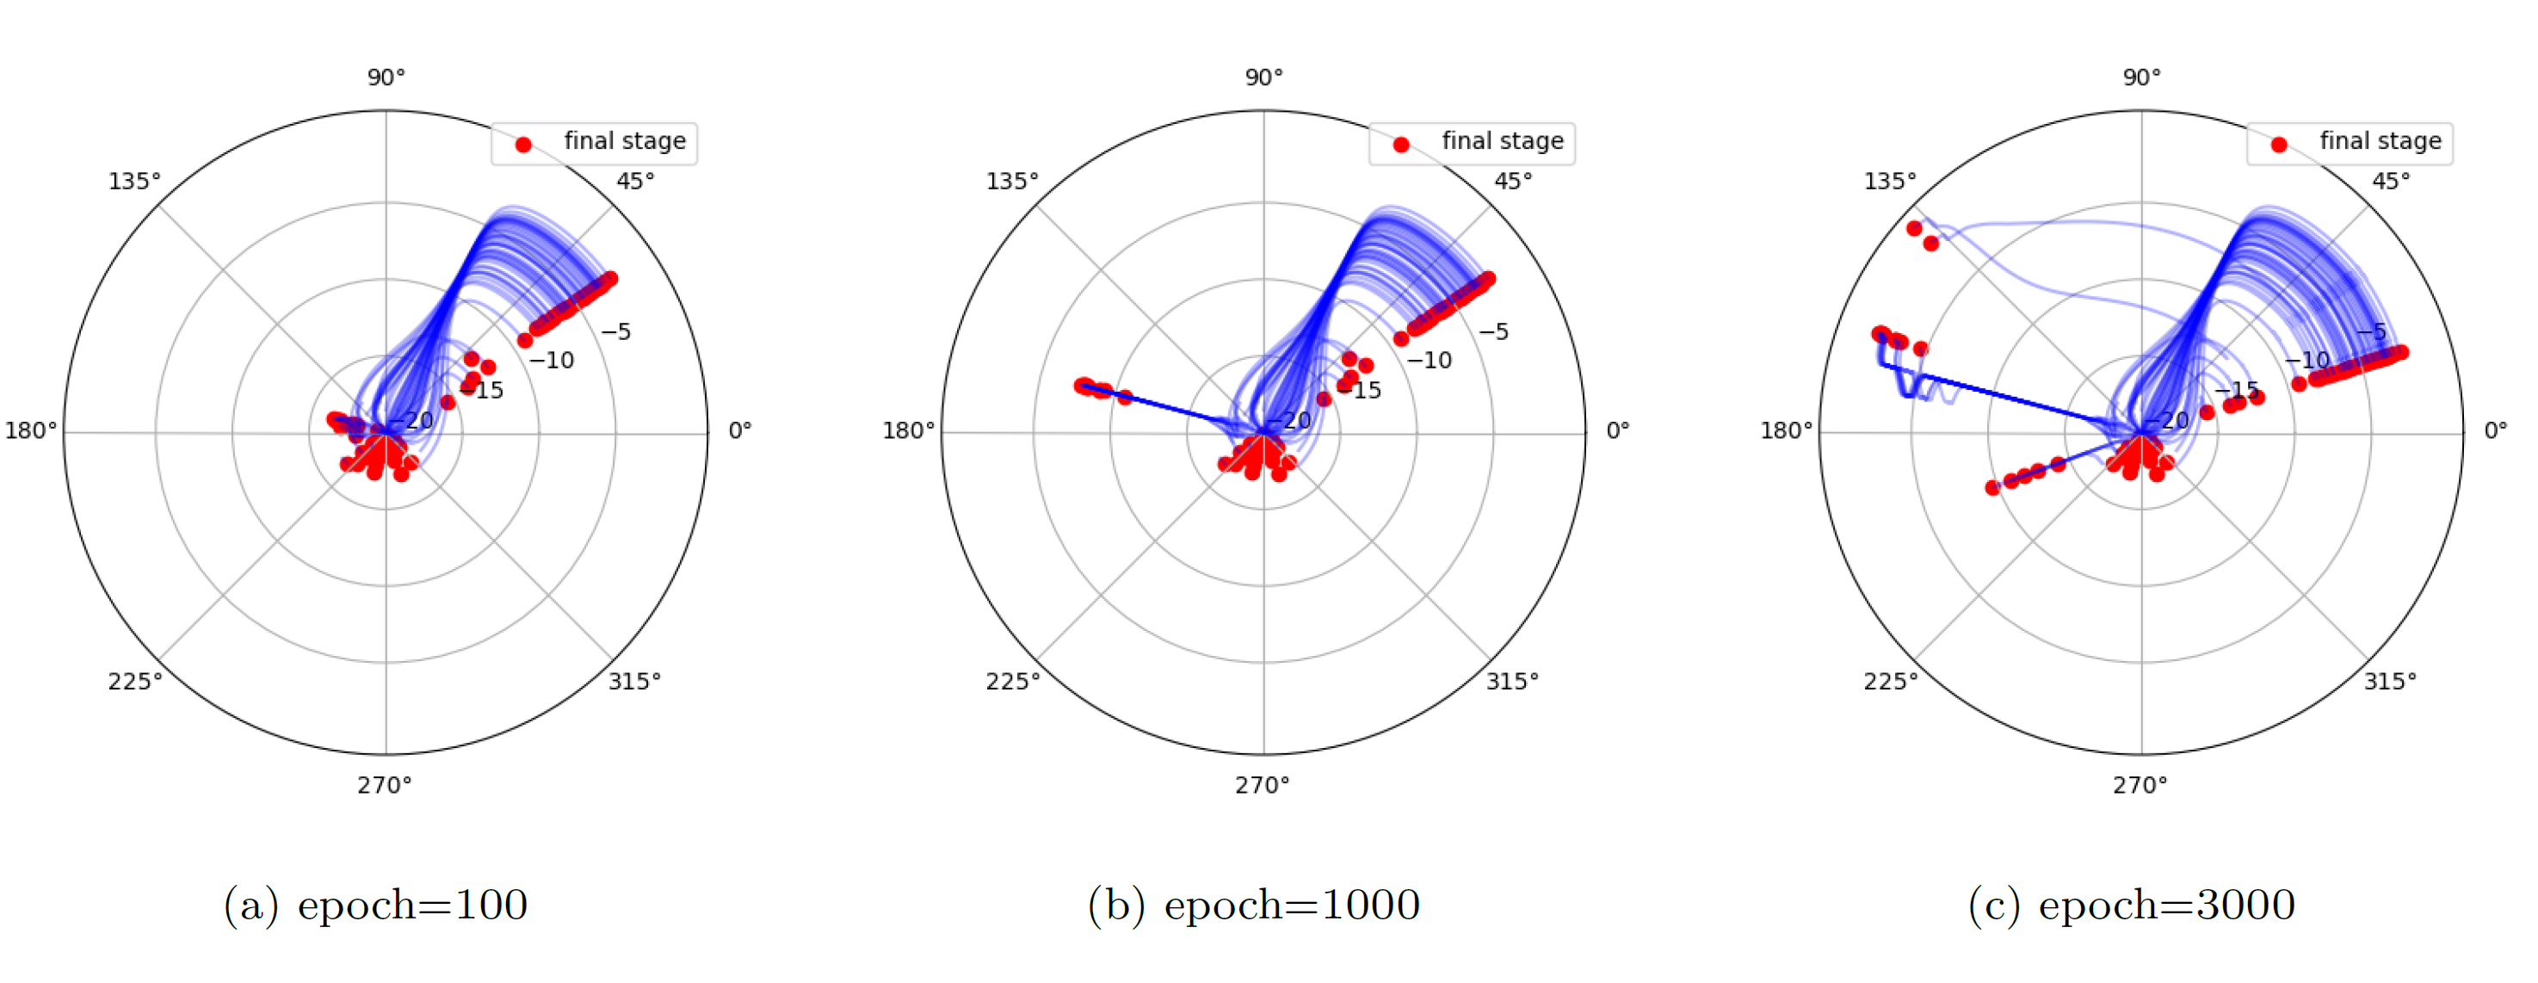
Evolution trajectory

Slide 6
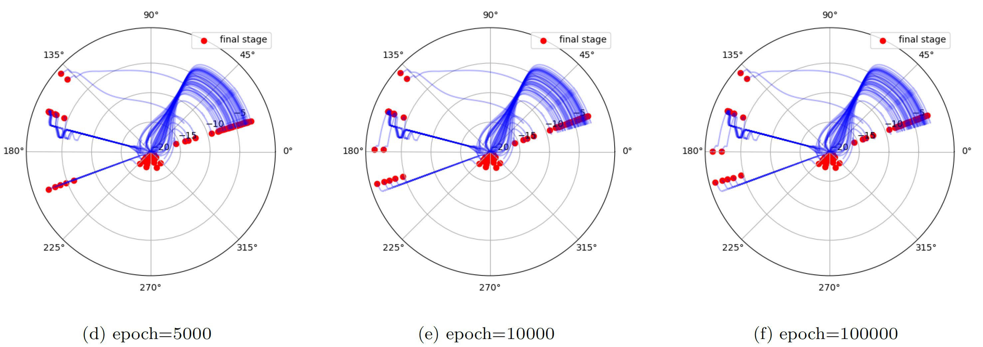
Evolution trajectory

Slide 7
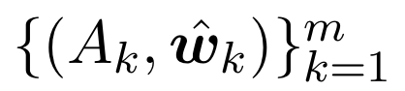
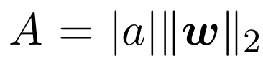
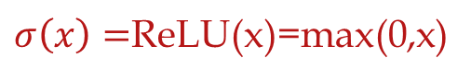
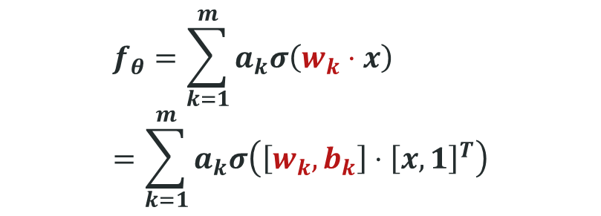
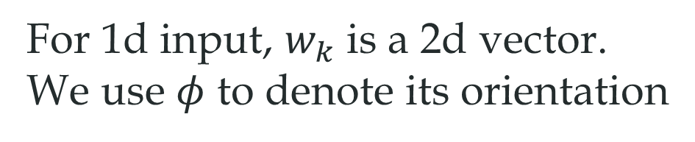
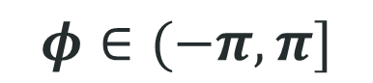
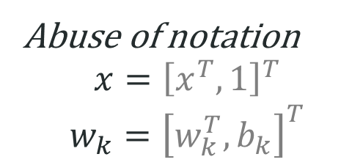
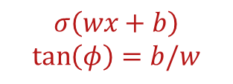
2-layer ReLU neural network
$$f_{θ}=\sum_{k=1}^{m}{a_{k}σ\left(w_{k}⋅x\right)}=\sum_{k=1}^{m}{a_{k}σ\left(\left[w_{k},b_{k}\right]⋅{\left[x,1\right]}^{T}\right)}$$
For 1d input, $w_{k}$ is a 2d vector.
We use $φ$ to denote its orientation
$σ\left(x\right)=$ReLU(x)=max(0,x)
Abuse of notation
$$x={\left[x^{T},1\right]}^{T}$$
$$w_{k}={\left[w_{k}^{T},b_{k}\right]}^{T}$$
$$σ\left(wx+b\right)$$
$$\tan\left(φ\right)=b/w$$
$$φ∈(−π,π]$$
Angle---Turning point
Tao Luo#, Zhi-Qin John Xu #, Zheng Ma, Yaoyu Zhang*,
Phase diagram for two-layer ReLU neural networks at infinite-width limit, Journal of Machine Learning Research (2021)

Slide 8
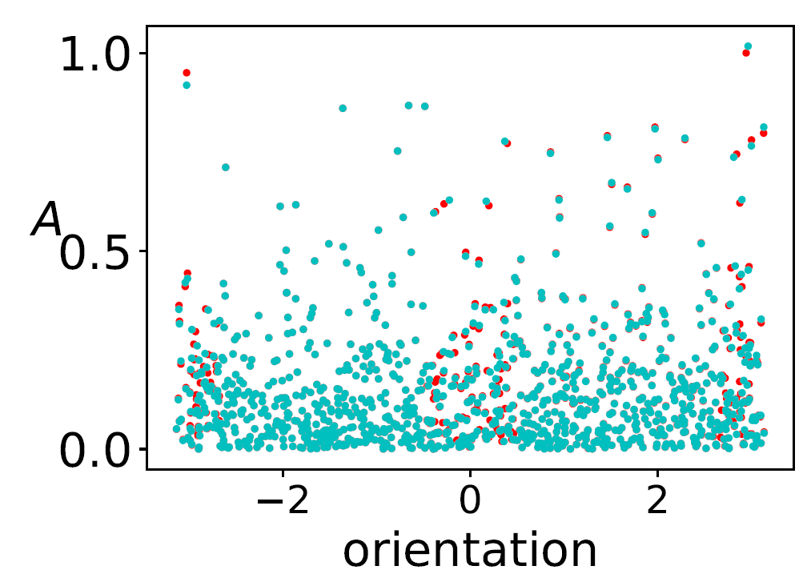
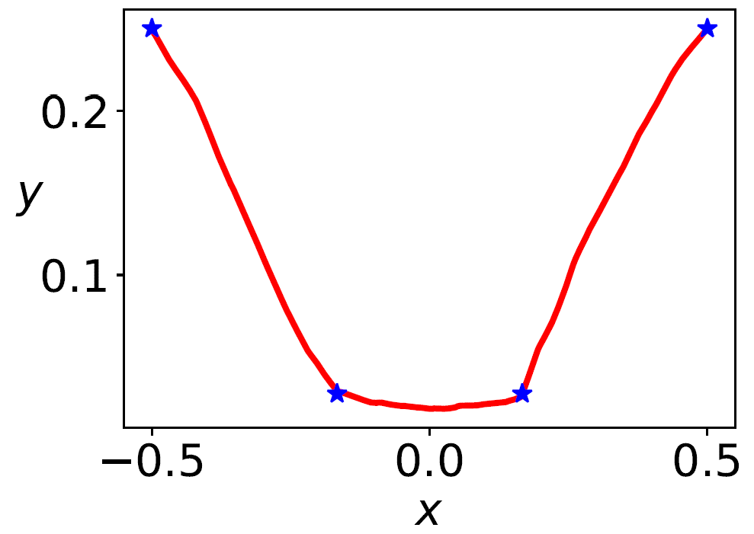
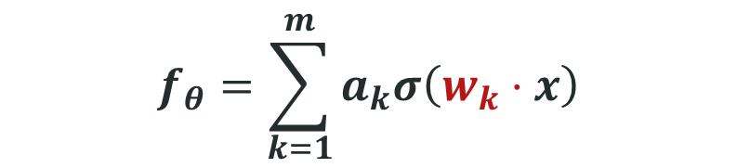
Linear regime
$$f_{θ}=\sum_{k=1}^{m}{a_{k}σ\left(w_{k}⋅x\right)}$$
Initial→ → Final
However, NN’s power is not in linear regime.
Tao Luo#, Zhi-Qin John Xu #, Zheng Ma, Yaoyu Zhang*,
Phase diagram for two-layer ReLU neural networks at infinite-width limit, Journal of Machine Learning Research (2021)

Slide 9
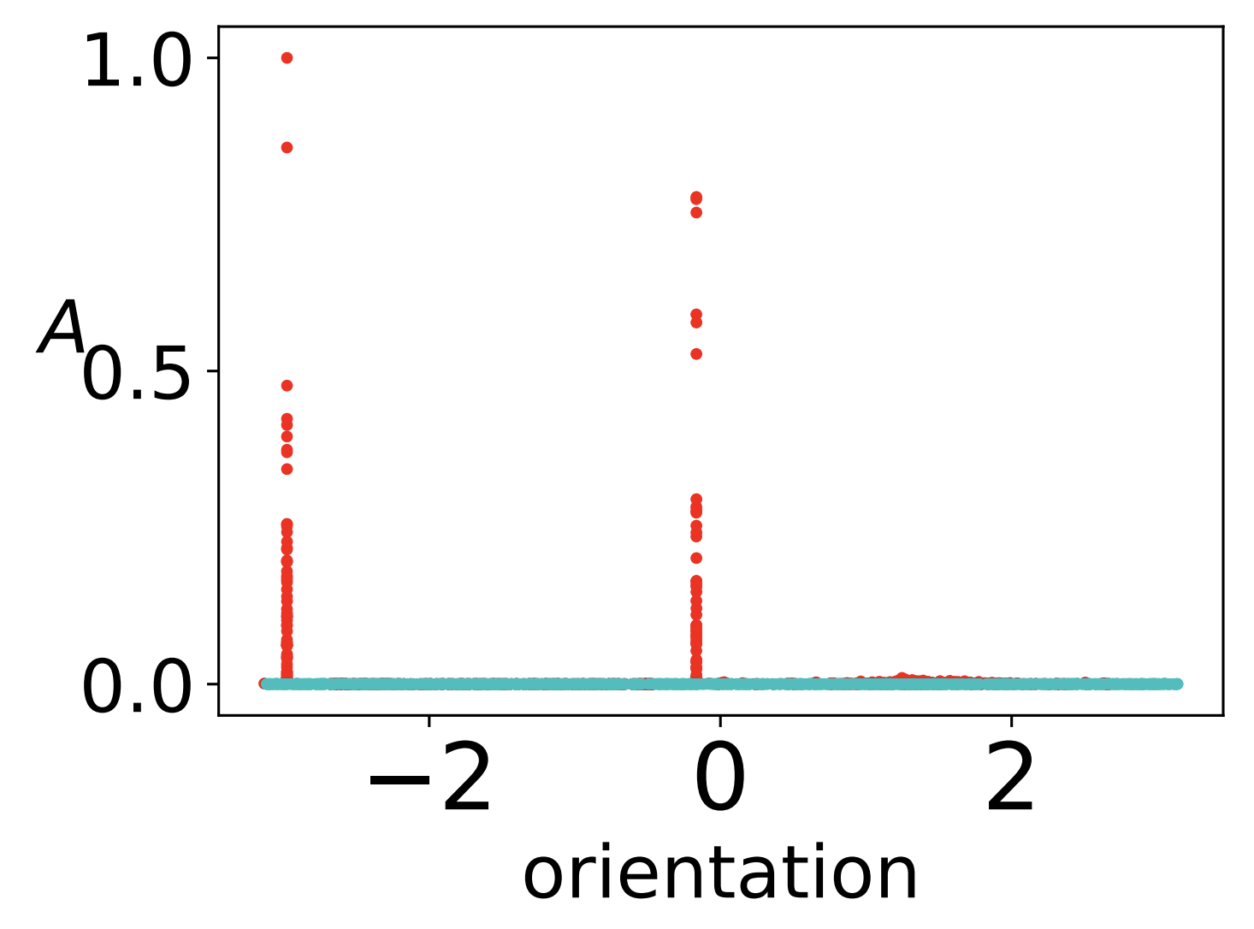
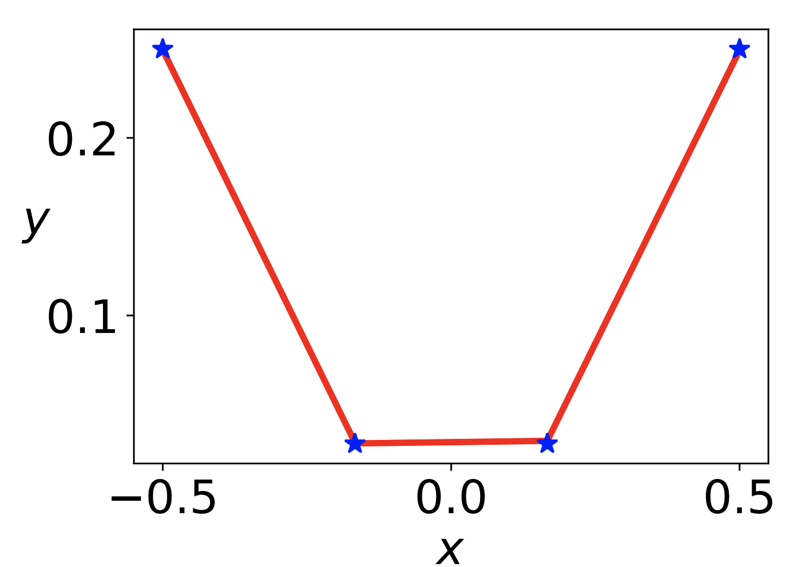
Condensation
$$f_{θ}=\sum_{k=1}^{m}{a_{k}σ\left(w_{k}⋅x\right)}$$
Initial→ → Final
Tao Luo#, Zhi-Qin John Xu #, Zheng Ma, Yaoyu Zhang*,
Phase diagram for two-layer ReLU neural networks at infinite-width limit, Journal of Machine Learning Research (2021)

Slide 10
What initialization leads to linearity or Condensation?
Tao Luo#, Zhi-Qin John Xu #, Zheng Ma, Yaoyu Zhang*,
Phase diagram for two-layer ReLU neural networks at infinite-width limit, Journal of Machine Learning Research (2021)

Slide 11
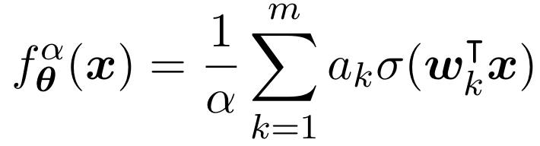
Phase diagram: condense in non-linear regime
Two-layer ReLU network
Luo#, Xu#, Ma, Zhang*, 2007.07497, JMLR; Zhou, Zhou, Jin Luo, Zhang, Xu*, NeurIPS 2022

Slide 12
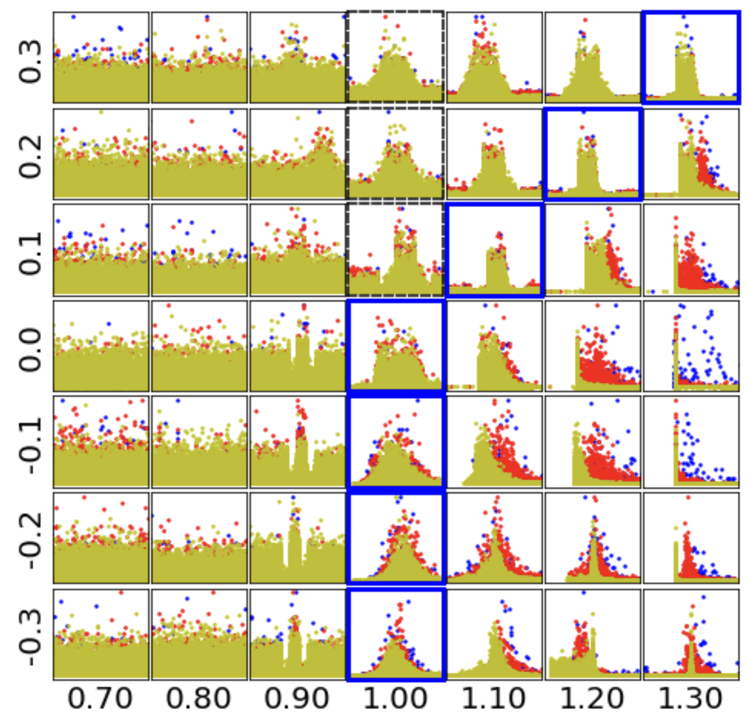
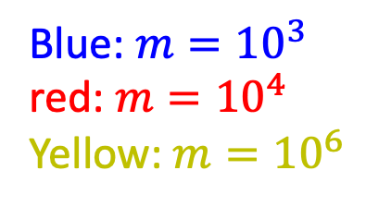
Feature distribution at the condensed regime
Blue: $m={10}^{3}$
red: $m={10}^{4}$
Yellow: $m={10}^{6}$
Tao Luo#, Zhi-Qin John Xu #, Zheng Ma, Yaoyu Zhang*,
Phase diagram for two-layer ReLU neural networks at infinite-width limit, Journal of Machine Learning Research (2021)

Slide 13
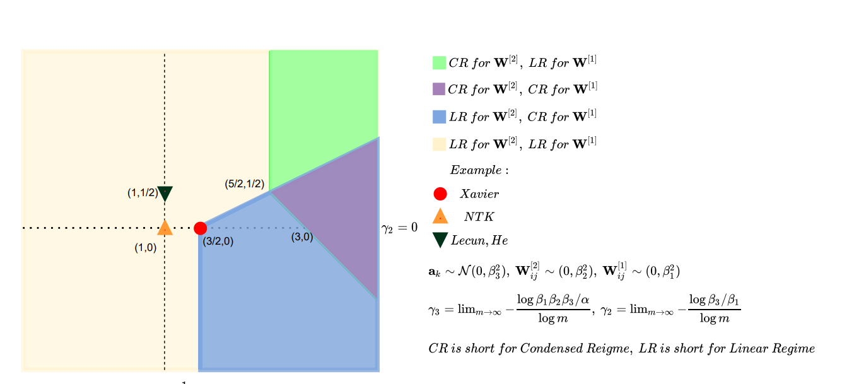
Phase diagram: condense in non-linear regime
Three-layer ReLU network
Luo#, Xu#, Ma, Zhang*, 2007.07497, JMLR; Zhou, Zhou, Jin Luo, Zhang, Xu, NeurIPS 2022

Slide 14
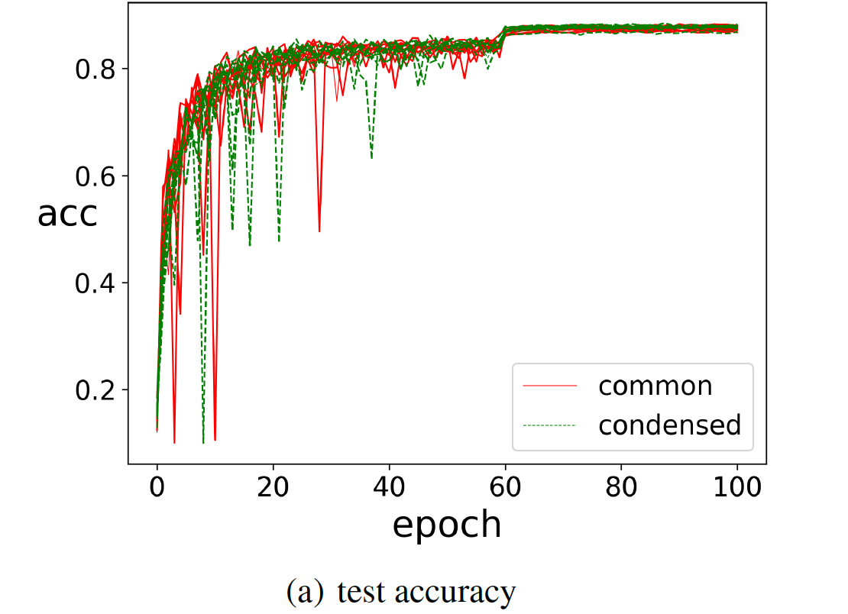
Resnet18, CIFAR10
Zhou, Zhou, Luo, Zhang*, Xu*, Towards Understanding the Condensation of Neural Networks at Initial Training, NeurIPS 2022

Slide 15
Condensation in practical nets?
Tao Luo#, Zhi-Qin John Xu #, Zheng Ma, Yaoyu Zhang*,
Phase diagram for two-layer ReLU neural networks at infinite-width limit, Journal of Machine Learning Research (2021)

Slide 16
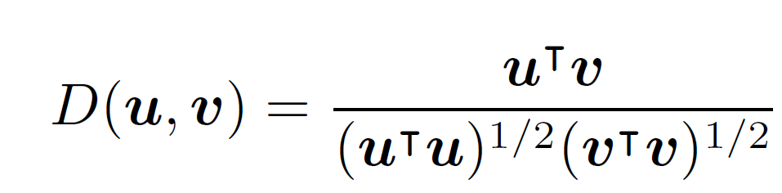
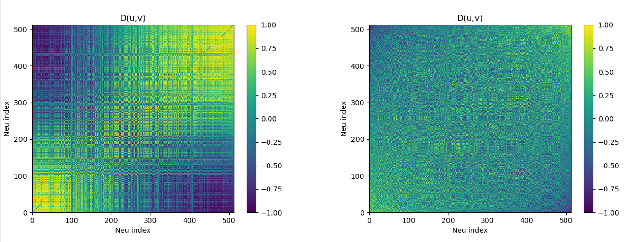
A layer in Resnet18
Each kernel is a unit, cosine similarity

Slide 17
Why Condense? Start from initial stage.
Zhou, Zhou, Luo, Zhang*, Xu*, Towards Understanding the Condensation of Neural Networks at Initial Training, NeurIPS 2022

Slide 18
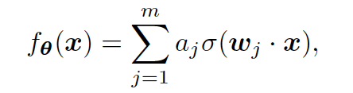
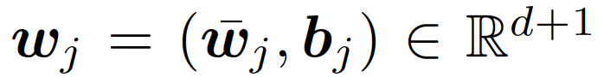
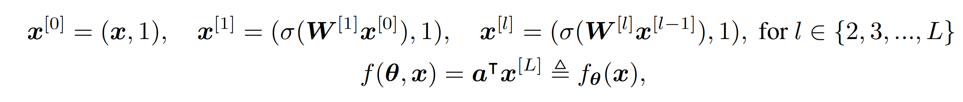
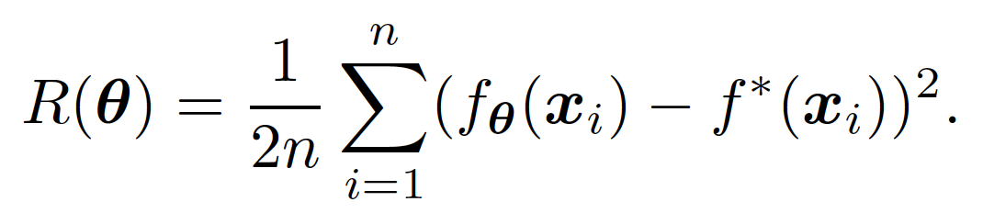
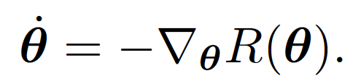
Network
Zhou, Zhou, Luo, Zhang*, Xu*, Towards Understanding the Condensation of Neural Networks at Initial Training, NeurIPS 2022

Slide 19
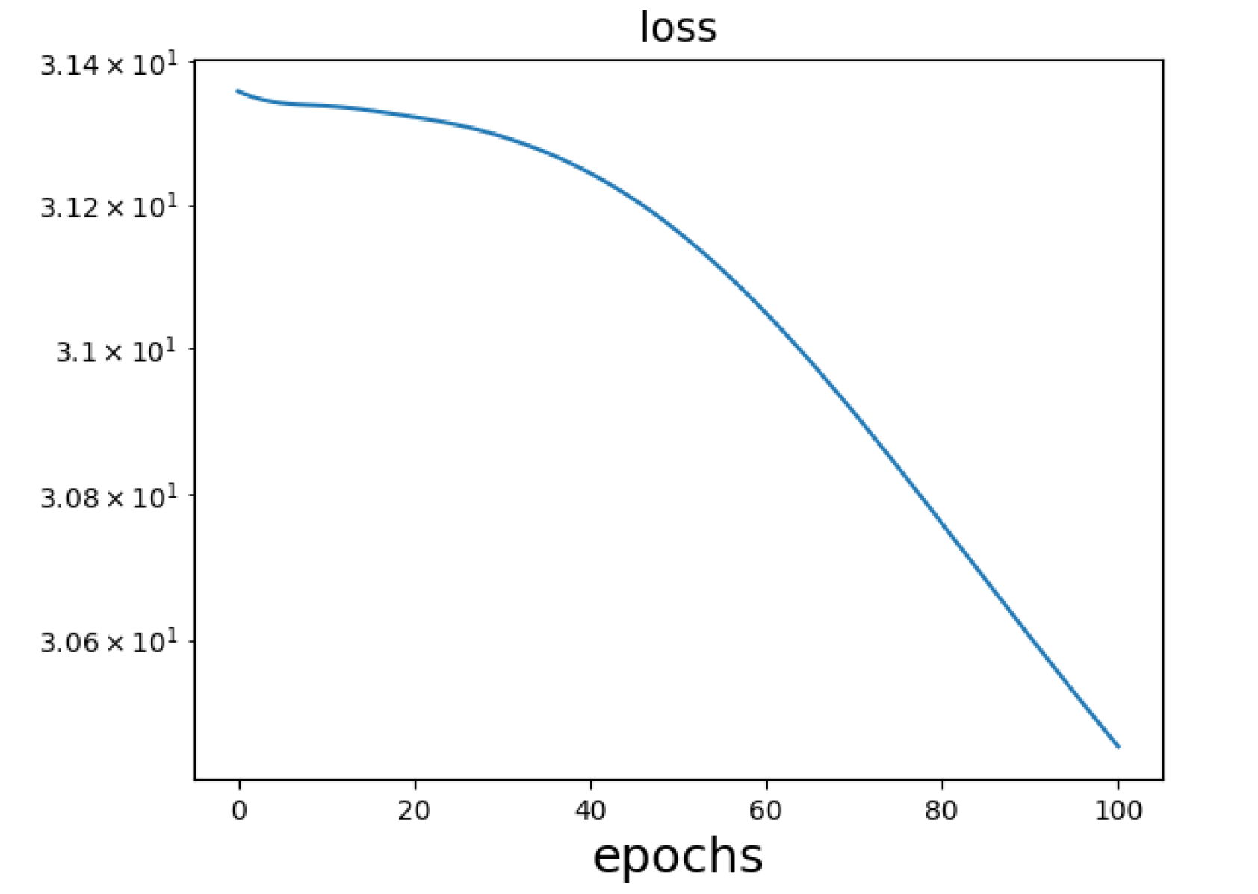
Initial stage
The period when the leading-order Taylor expansion w.r.t activated neurons is still valid
$$h\left(x, θ(t)\right)=h\left(x,θ_{0}\right)+∇_{θ}h(x,θ_{0})\left(θ\left(t\right)−θ_{0}\right)$$
Zhou, Zhou, Luo, Zhang*, Xu*, Towards Understanding the Condensation of Neural Networks at Initial Training, NeurIPS 2022

Slide 20
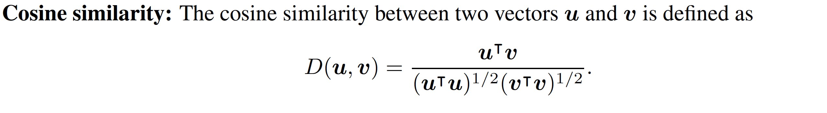
Cosine similarity
Characterize similarity of two vectors
Zhou, Zhou, Luo, Zhang*, Xu*, Towards Understanding the Condensation of Neural Networks at Initial Training, NeurIPS 2022

Slide 21
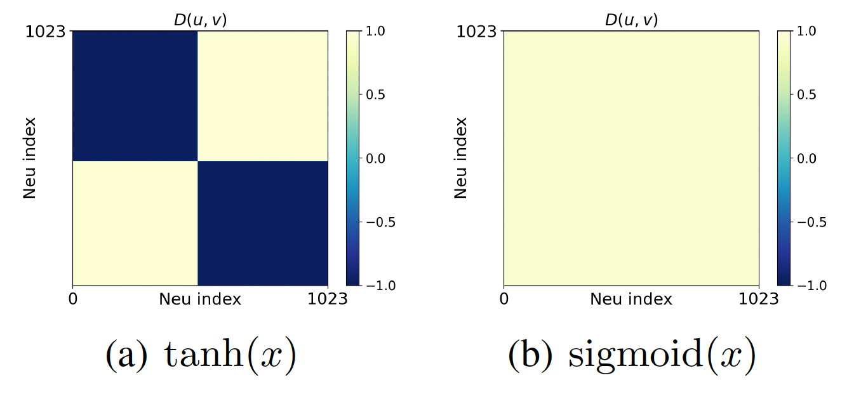
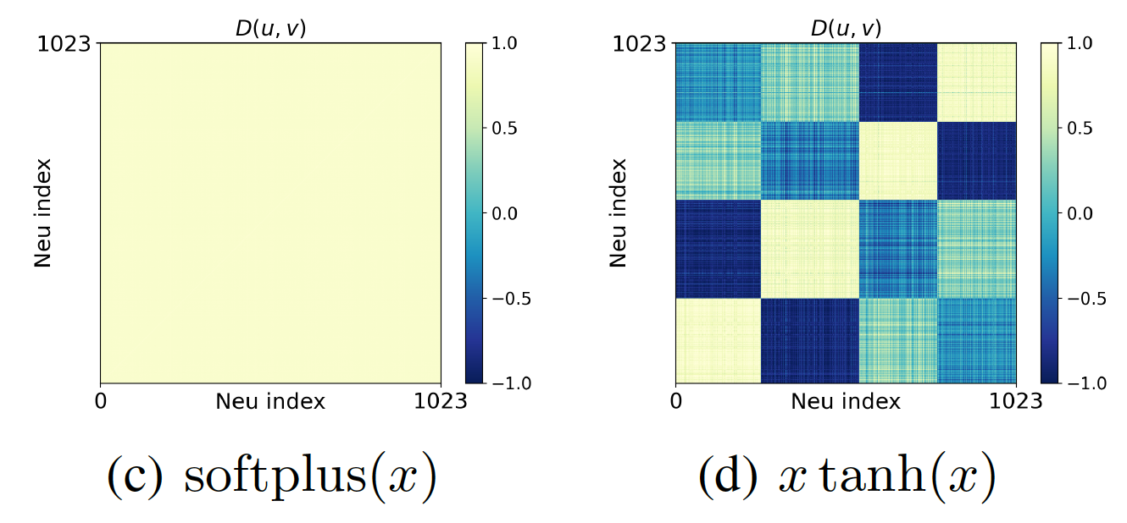
Initial condensation for CNN
Resnet18
CIFAR10
fully-connected layer
ReLU for conv layers
FC with other act func
Adam
epoch 20, 30, 30, 61
Zhou, Zhou, Luo, Zhang*, Xu*, Towards Understanding the Condensation of Neural Networks at Initial Training, NeurIPS 2022

Slide 22
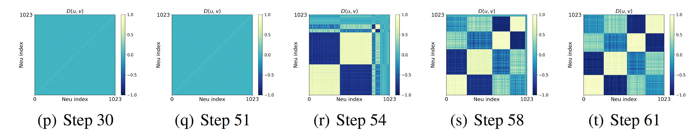
Initial condensation for CNN
Training process
Zhou, Zhou, Luo, Zhang*, Xu*, Towards Understanding the Condensation of Neural Networks at Initial Training, NeurIPS 2022

Slide 23
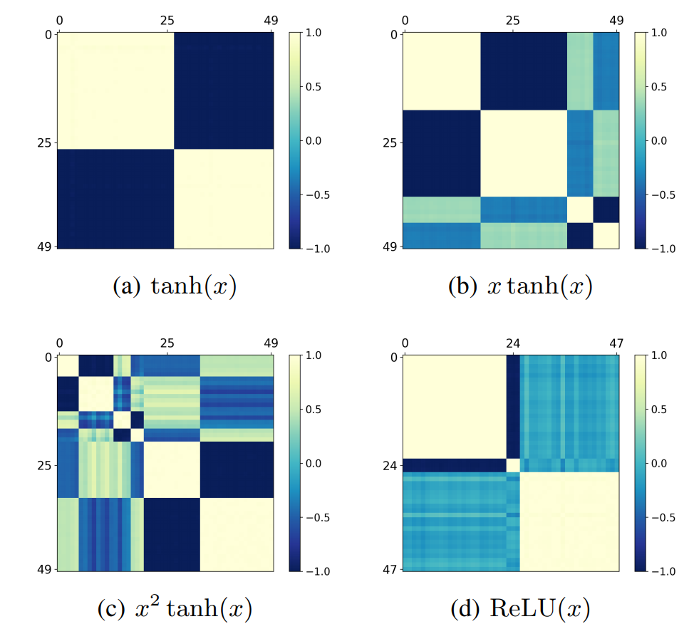
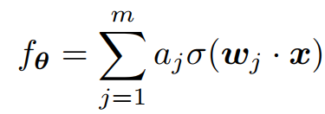
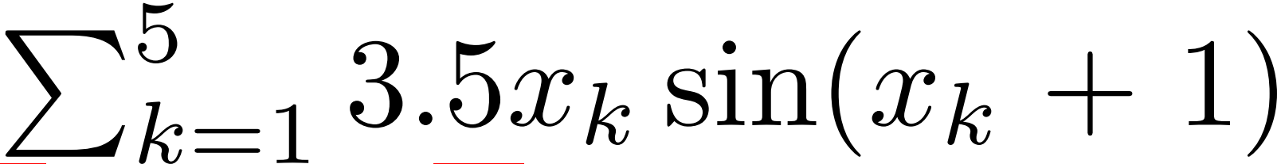
Two-layer synthetic
Net:
Target function:
Zhou, Zhou, Luo, Zhang*, Xu*, Towards Understanding the Condensation of Neural Networks at Initial Training, NeurIPS 2022

Slide 24
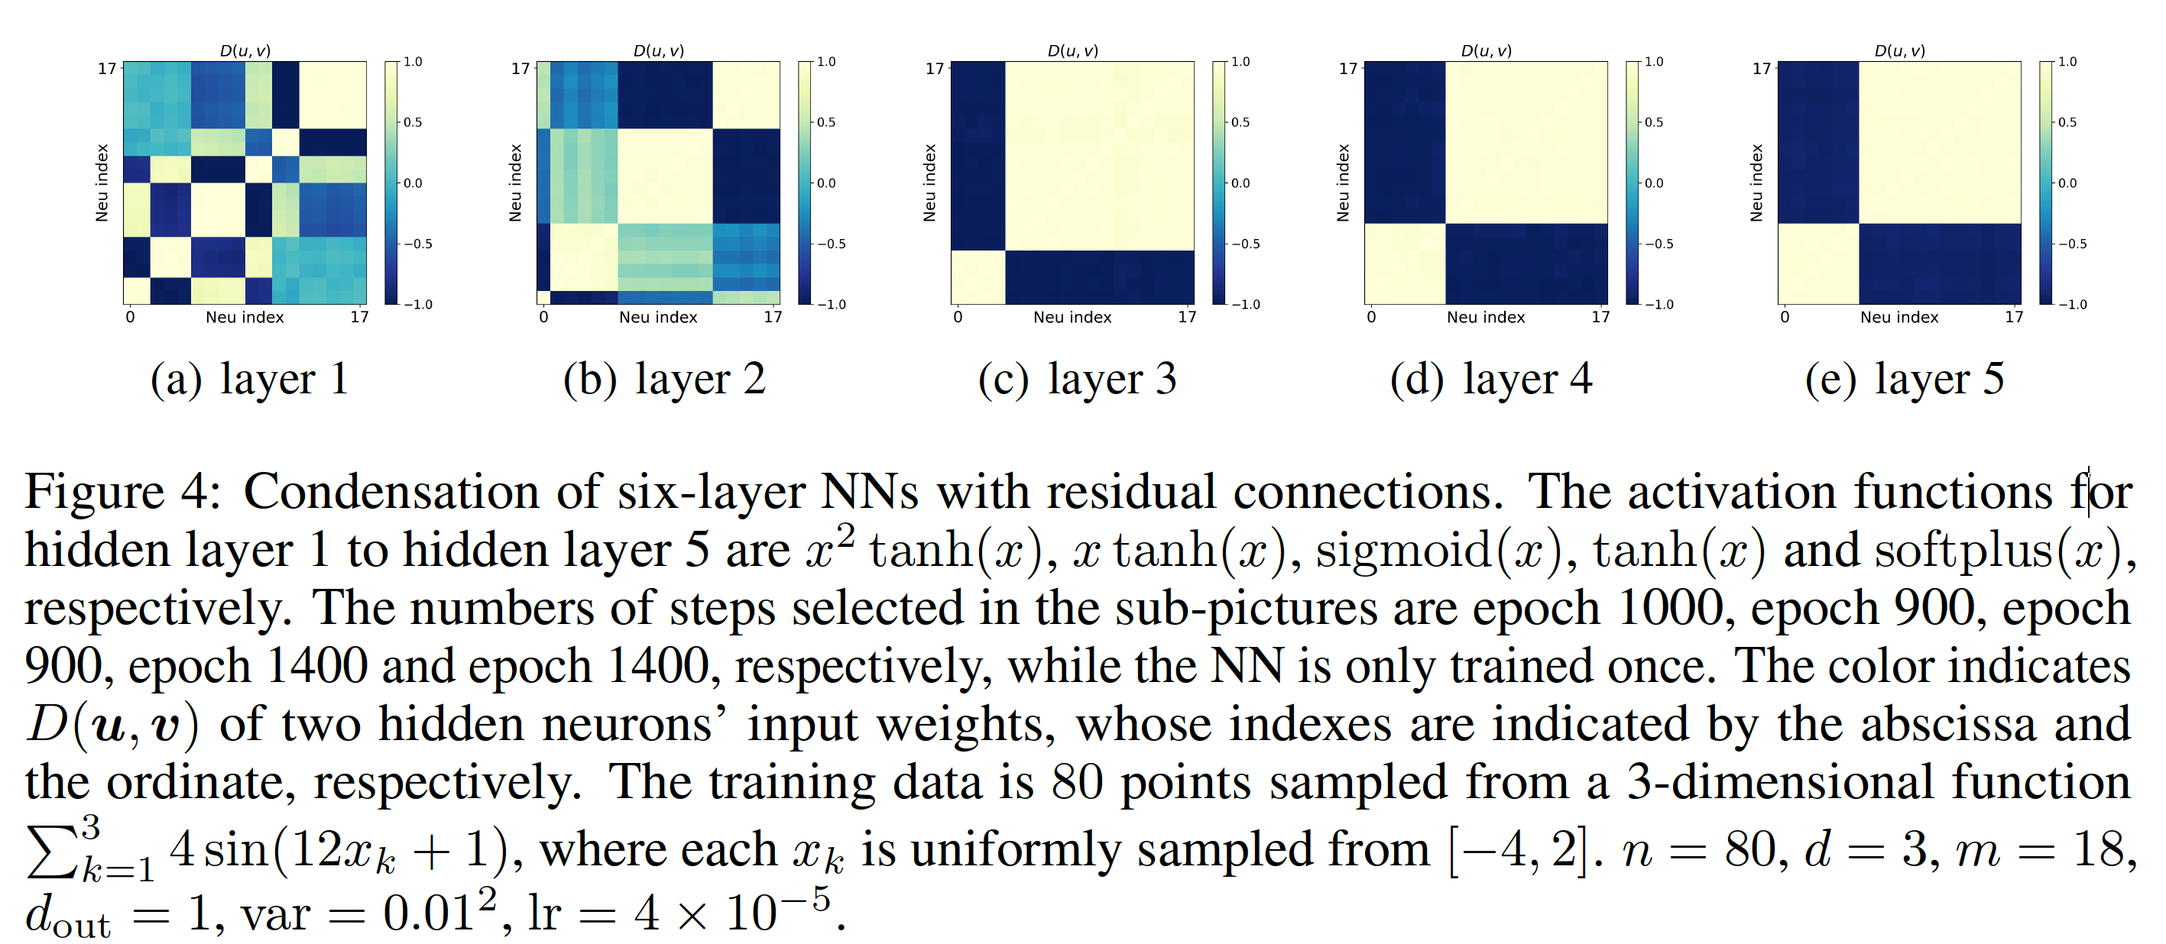
Multiple-layer synthetic
Zhou, Zhou, Luo, Zhang*, Xu*, Towards Understanding the Condensation of Neural Networks at Initial Training, NeurIPS 2022

Slide 25
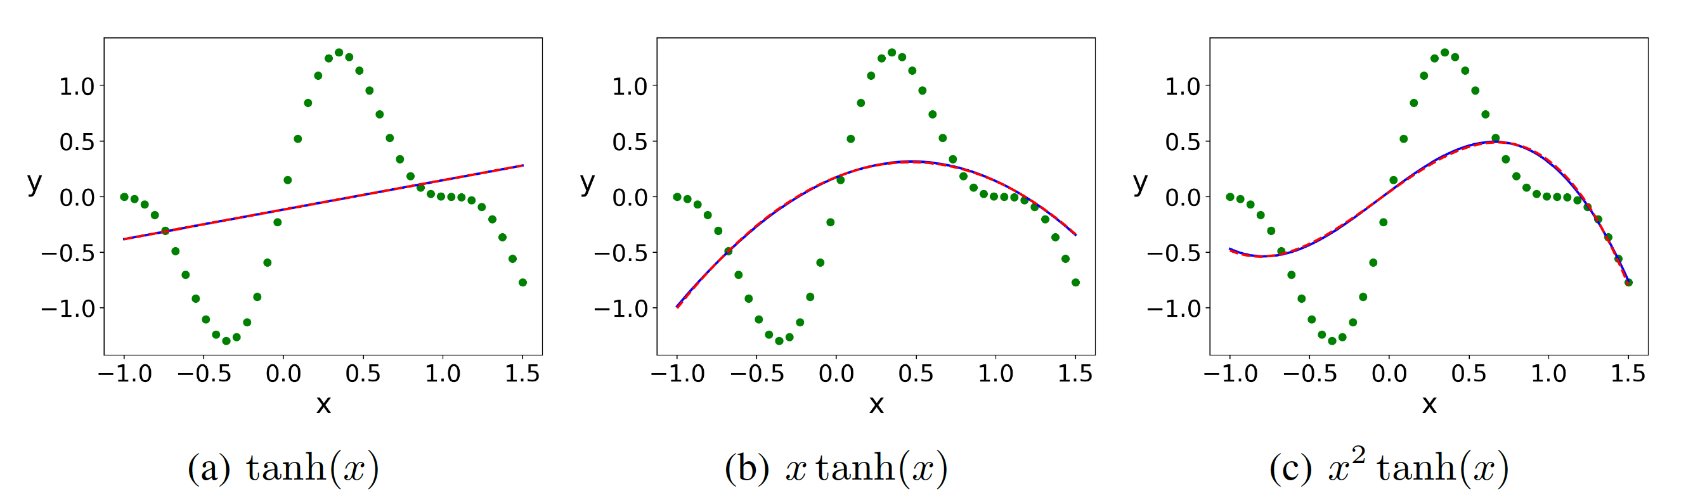
Analysis of initial stage
Zhou, Zhou, Luo, Zhang*, Xu*, Towards Understanding the Condensation of Neural Networks at Initial Training, NeurIPS 2022

Slide 26
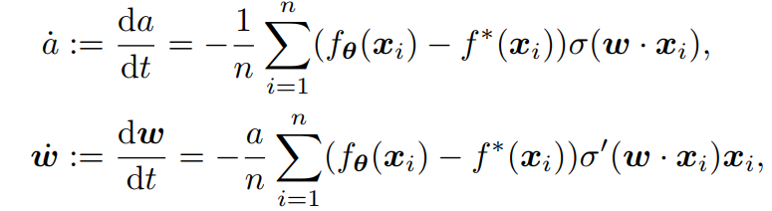
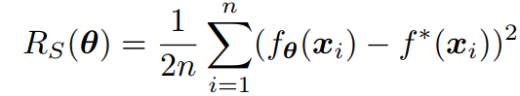
Velocity field
Zhou, Zhou, Luo, Zhang*, Xu*, Towards Understanding the Condensation of Neural Networks at Initial Training, NeurIPS 2022

Slide 27
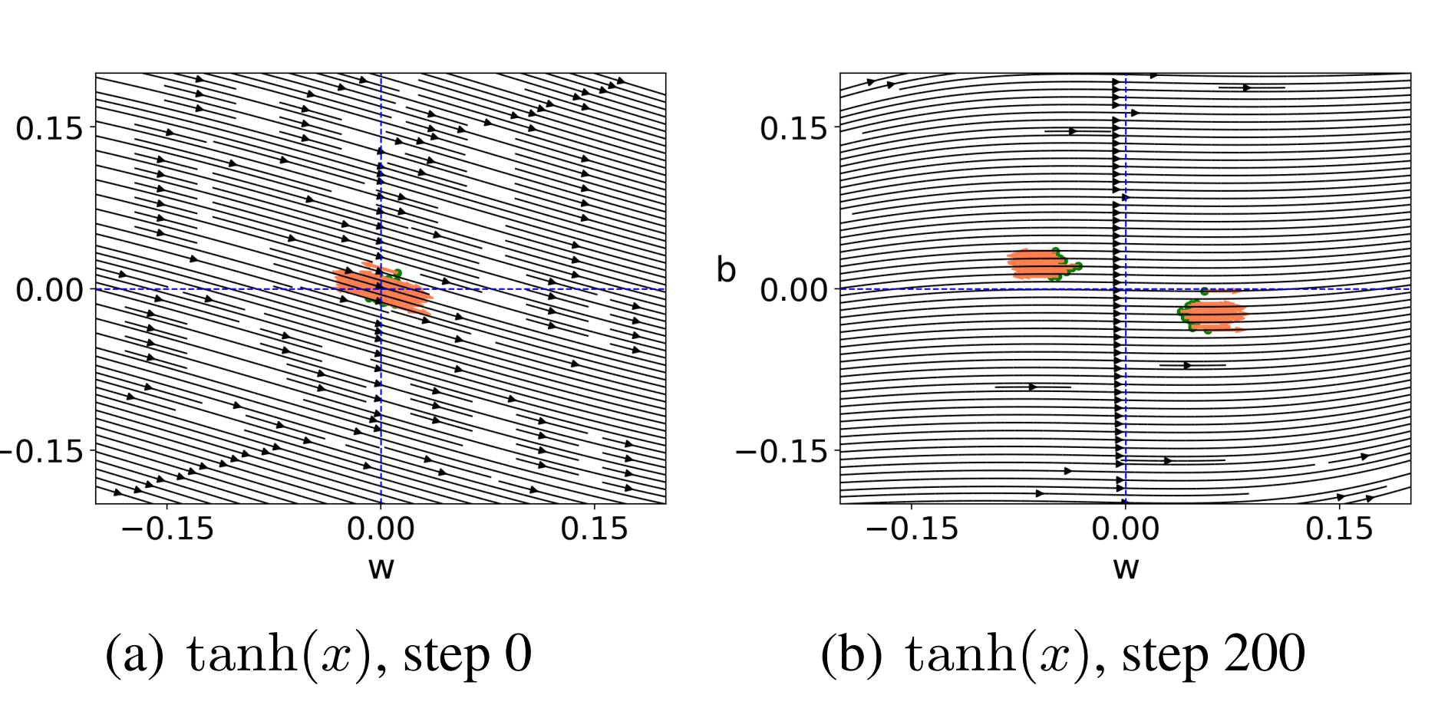
Tanh(x)
Zhou, Zhou, Luo, Zhang*, Xu*, Towards Understanding the Condensation of Neural Networks at Initial Training, NeurIPS 2022

Slide 28
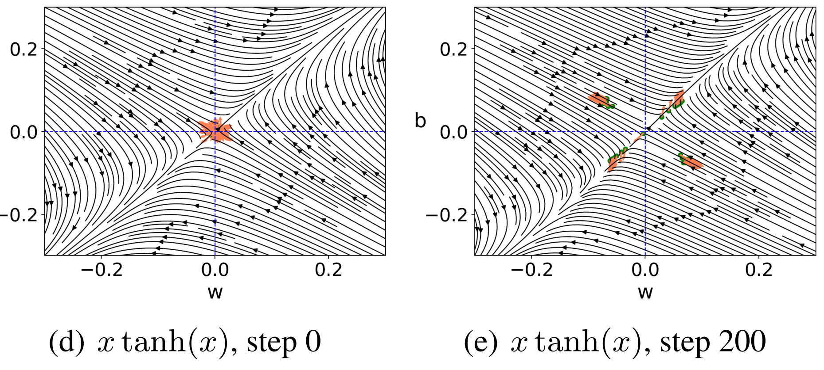
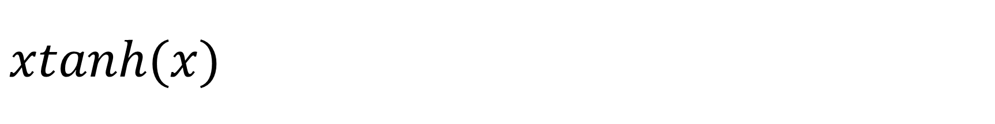
$$xtanh(x)$$
Zhou, Zhou, Luo, Zhang*, Xu*, Towards Understanding the Condensation of Neural Networks at Initial Training, NeurIPS 2022

Slide 29
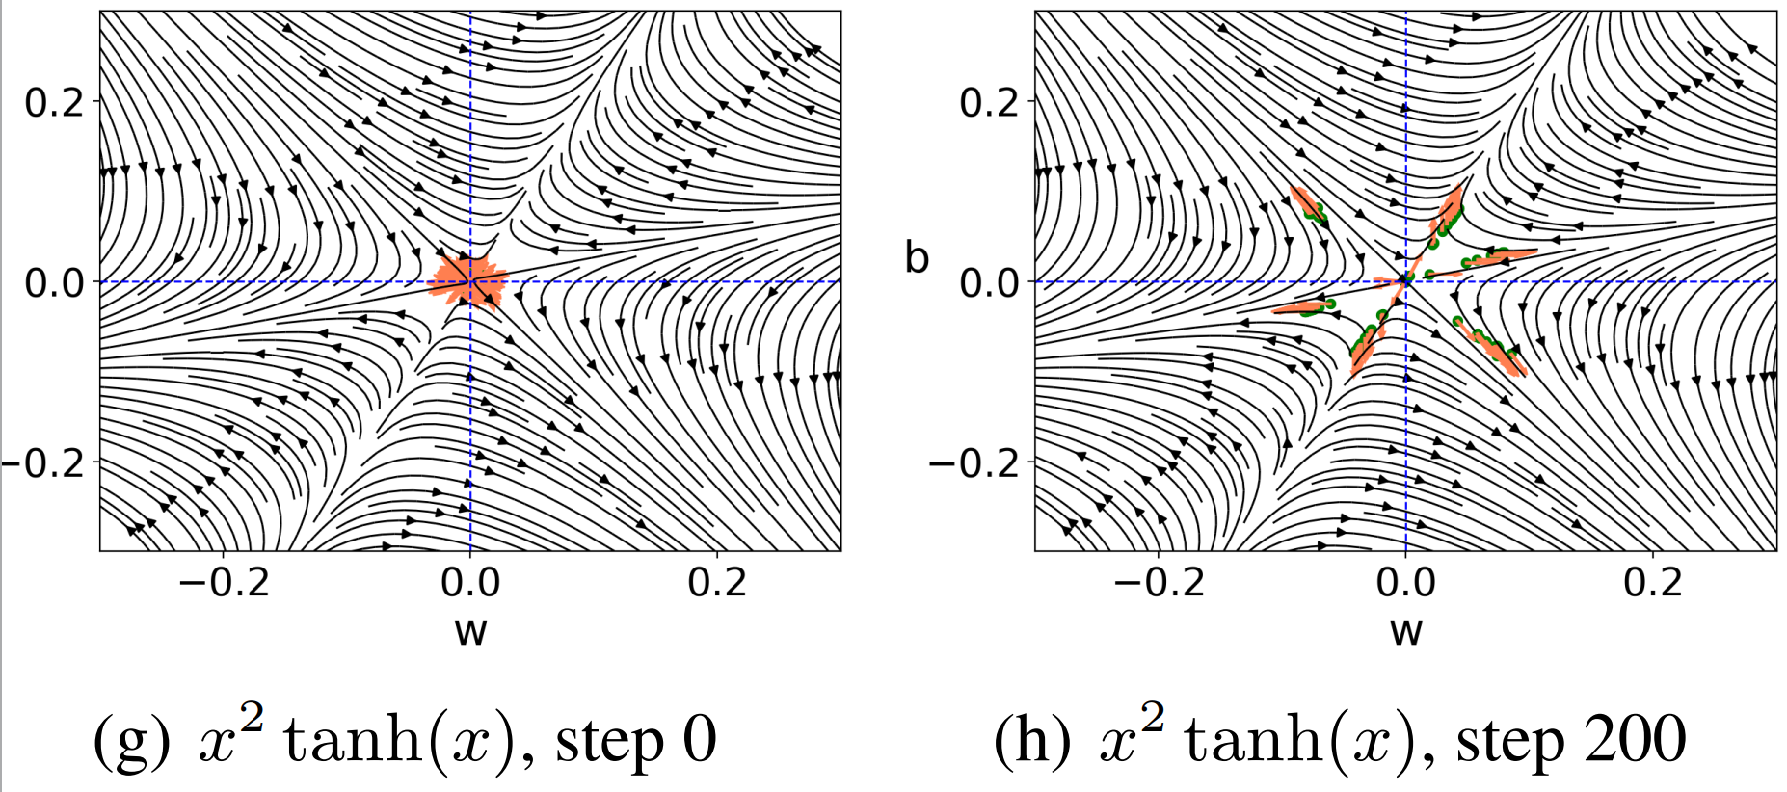

$$x^{2}tanh⁡(x)$$
Zhou, Zhou, Luo, Zhang*, Xu*, Towards Understanding the Condensation of Neural Networks at Initial Training, NeurIPS 2022

Slide 30


$$ReLU(x)$$
Zhou, Zhou, Luo, Zhang*, Xu*, Towards Understanding the Condensation of Neural Networks at Initial Training, NeurIPS 2022

Slide 31







A simple analysis
Zhou, Zhou, Luo, Zhang*, Xu*, Towards Understanding the Condensation of Neural Networks at Initial Training, NeurIPS 2022

Slide 32



The influence of training data
Simple data, condense less
Zhou, Zhou, Luo, Zhang*, Xu*, Towards Understanding the Condensation of Neural Networks at Initial Training, NeurIPS 2022

Slide 33
Phase diagram of initial condensation for smooth activations 估计初始凝聚的时间
Zhengan Chen, Yuqing Li*, Tao Luo, Zhangchen Zhou, Zhi-Qin John Xu*, Phase Diagram of Initial Condensation for Two-layer Neural Networks, arxiv 2303.06561

Slide 34

Similar to ReLU
Zhengan Chen, Yuqing Li*, Tao Luo, Zhangchen Zhou, Zhi-Qin John Xu*, Phase Diagram of Initial Condensation for Two-layer Neural Networks, arxiv 2303.06561

Slide 35

Linear regime
Assumption 2: p=1
Assumption 4: non-parallel data
Assumption 5: large width
Zhengan Chen, Yuqing Li*, Tao Luo, Zhangchen Zhou, Zhi-Qin John Xu*, Phase Diagram of Initial Condensation for Two-layer Neural Networks, arxiv 2303.06561

Slide 36



Initial Condensed regime
Assumption 2: p=1
Assumption 3:
Assumption 5: large width
Zhengan Chen, Yuqing Li*, Tao Luo, Zhangchen Zhou, Zhi-Qin John Xu*, Phase Diagram of Initial Condensation for Two-layer Neural Networks, arxiv 2303.06561

Slide 37



w waits for a
a waits for w
Zhengan Chen, Yuqing Li*, Tao Luo, Zhangchen Zhou, Zhi-Qin John Xu*, Phase Diagram of Initial Condensation for Two-layer Neural Networks, arxiv 2303.06561

Slide 38

w-lag regime
Zhengan Chen, Yuqing Li*, Tao Luo, Zhangchen Zhou, Zhi-Qin John Xu*, Phase Diagram of Initial Condensation for Two-layer Neural Networks, arxiv 2303.06561

Slide 39

a-lag regime
Zhengan Chen, Yuqing Li*, Tao Luo, Zhangchen Zhou, Zhi-Qin John Xu*, Phase Diagram of Initial Condensation for Two-layer Neural Networks, arxiv 2303.06561

Slide 40
小结：凝聚现象
小初始化下，GD训练，会使同层神经元趋同
训练过程，凝聚方向逐渐增加
初始阶段，由于神经元相同的动力学，导致初始凝聚。

Slide 41
更多的问题
为什么GD训练会逐渐增加凝聚的方向？
为什么我们不直接训练一个小的网络，而是要训练一个大的网络，发生凝聚后，等价于一个小网络？
初始化太小，虽然能产生凝聚，但其训练会非常慢？是否可以找到既能快速训练，又能产生凝聚的训练方法？
我们是否能利用凝聚来设计更好的算法？

